Slide 1

Robustness in Decision-Aiding
Tours, November 13, 2003
Ph. Vincke
Université Libre de Bruxelles
S.M.G.
pvincke@smg.ulb.ac.be

Slide 2
Uncertainties in the decision aiding process
Decision problem
Choice of the type of model
Choice of the values for the
parameters of the model
Uncertainties on the external
environment (“data”)
?
Robustness of the conclusions
(solutions, decisions, …)

Slide 3
Example 1 (1)
A system in state A must be transformed in state B with a transition through state C or state D.
Transition costs:
A to C : 7 or 12
A to D : 10
C to B : 12
D to B : 10

Slide 4
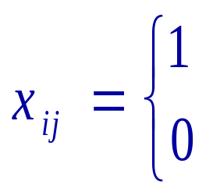
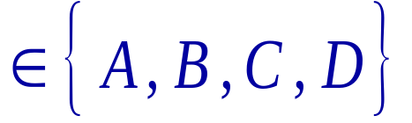
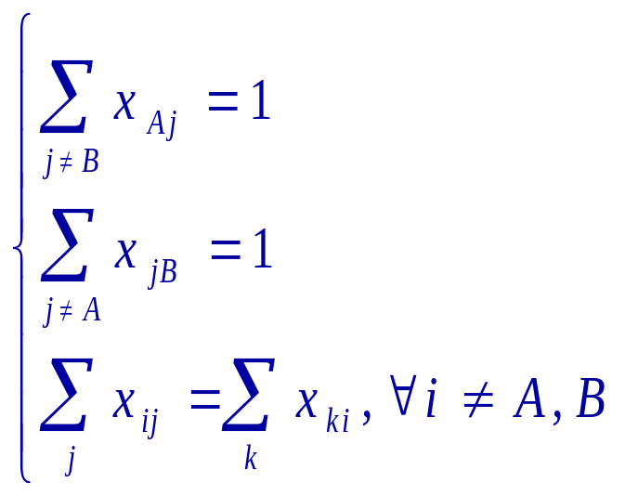
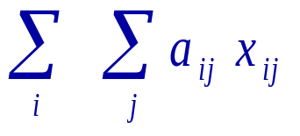
Example 1 (2)
if transition (i,j) is chosen
Let
if not
where i and j
Minimize

Slide 5
Example 1 (3)
Find the shortest path from A to B in
C
C
7
12
or
12
12
A
B
A
B
10
10
10
10
D
D

Slide 6
Example 2: Minimum spanning tree
2
10
8
8
1
3
5
2
3
5
10
4
Value: 8 or 17
Value: 14 or 9
Value: 9 or 10

Slide 7
Traditional tools to cope with uncertainties
Probability theory
Possibility theory
Fuzzy sets
Belief functions
Rough sets

Slide 8
Example 3
Version 1 Version 2
a 50 190
b 200 40
c 110 110
Mean
120
120
110
No set of probabilities will lead to c.

Slide 9
Conclusion
We need a new framework and new methodologies to take into account the irreducible parts of ignorance and uncertainty contained in any decision aiding process.

Slide 10
Robustness versus stability
Stability: results from an a posteriori sensitivity
analysis on a result calculated in a
particular version of the problem.
Robustness: results from an a priori integration
of several versions in the model and
from the search for a result taking
all these versions into account.

Slide 11
Different definitions of robustness (1)
Robust decision in a dynamic context (Rosenhead)
Robust solution in optimization problems (Rosenblatt and Lee, Sengupta, Mulvey et al., Kouvelis and Yu, Vincke)

Slide 12
Different definitions of robustness (2)
Robust conclusion (Roy)
Robust method (Vincke, Sorensen)

Slide 13
Robustness in a dynamic context
A decision at a given time is robust if it keeps open the possibility of taking good decisions in the future.

Slide 14
Robustness in optimization problems
Rosenblatt and Lee (1987)
Sengupta (1991)
Mulvey et al. (1994)
Kouvelis and Yu (1992, 1997)
  absolute robustness
  deviation robustness
  relative deviation robustness

Slide 15
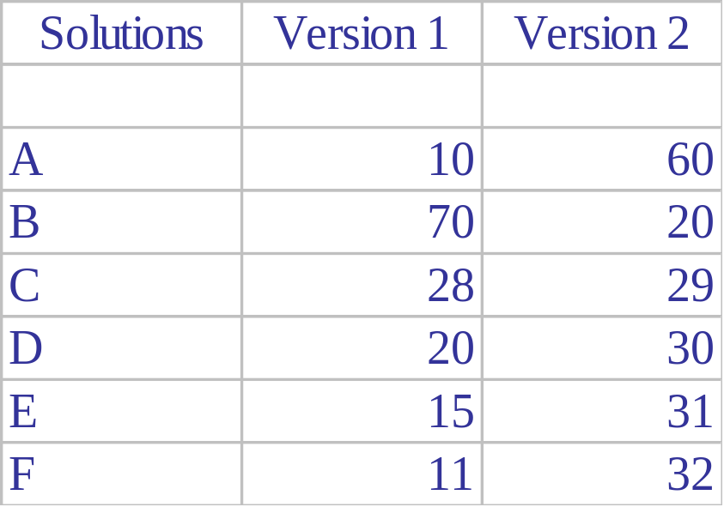
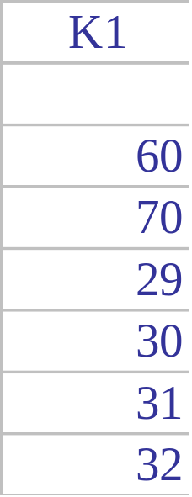
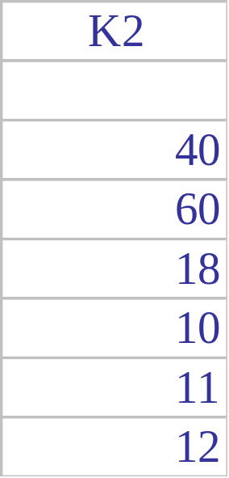
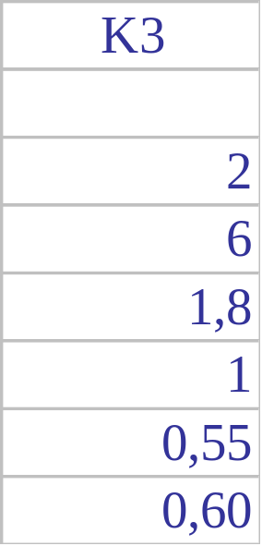
The 3 definitions of Kouvelis and Yu

Slide 16
Robust solution in an optimization problem (1)
A solution which is feasible for all the versions and whose value is distant from the optimum by maximum 10% in all the versions.
A solution which belongs to the 10 (or the 10%) best solutions in each version.

Slide 17
Robust solution in an optimization problem (2)
A solution which is feasible in 95% of the versions and « quasi-optimal » in all the versions where it is feasible.
A solution which is feasible in « most » of the versions, « very good » in « many » versions and « not too bad » in the others.

Slide 18
Robust conclusion
Roy (1998)
A conclusion is robust if it is true for all (almost) the plausible sets of values for the parameters of the model used in the decision aiding process.

Slide 19
Example 4 (1)
Production of 30T of mixture of A and B.
No more than 20T of the same product.
Benefit Version 1 Version 2
A 20 10
B 10 30

Slide 20
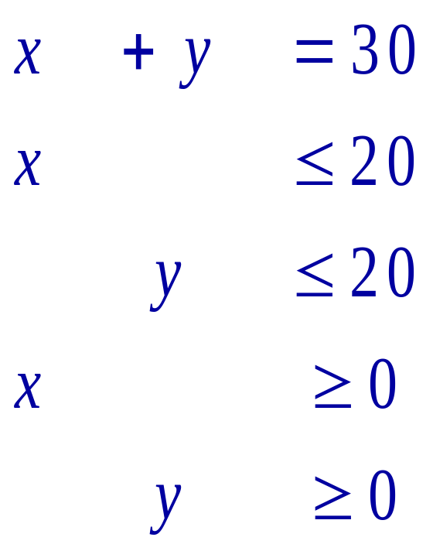
Example 4 (2)
Maximize
20x + 10y
or
10x + 30y

Slide 21
Example 4 (2)
There exists a solution giving a total benefit
≥ 500 (x = 20, y = 10)
The total benefit will be inferior to 700
The solution x = y = 15 is not optimal

Slide 22
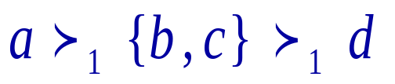
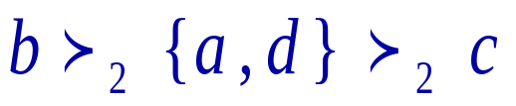
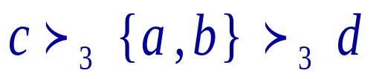
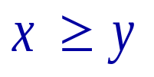
Example 5 (1)
Criterion 1:
Criterion 2:
Criterion 3:
Method: iff the sum of the weights of the criteria suppor-
ting this assertion represents at least 50% of the total sum
of the weights.

Slide 23
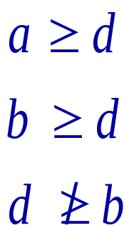
Example 5 (2)
No information on the weights
Robust conclusions
a
Robust solution
b
•
d
c

Slide 24
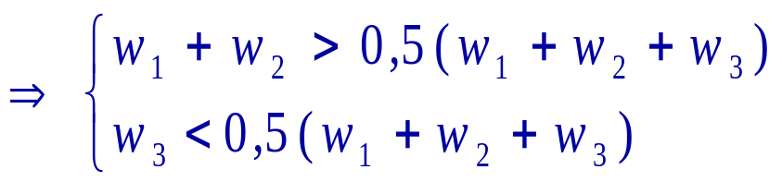


Example 5 (3)
New information: a > c
4 possibilities

Slide 25
Example 5 (4)
a
b
a
b







d
c
d
c
a
b
a
b









d
c
d
c

Slide 26
Example 5 (5)
Strict robustness
a
b


d
c
«Supple» robustness
a
b




d
c

Slide 27
Robust method
Vincke (1999)
A method is robust if it provides solutions (decisions, conclusions) which are good (valid) for all (almost) the plausible sets of values given to the parameters of the method (metaheuristics, multicriteria methods)
See also Sorensen (2001) for Tabu Search

Slide 28
Robust method
Giving a definition of robust solution for a problem, find a method which provides robust solutions.
Example: see Vincke (1999)
N.B.: necessity to introduce an idea of
«neutrality» of the method.

Slide 29
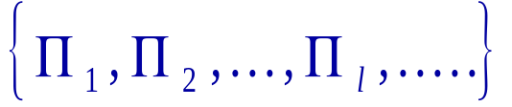
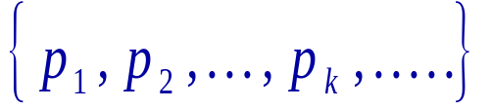

A theoretical framework (1)
= set of versions of the problem
= set of procedures = method
s_{kl} = solution given by the application of procedure p_{k} to the version

Slide 30
A theoretical framework (2)
S = a subset of {s_{kl}}
A solution s is robust relatively to S if it is “compatible” with all the solutions s_{kl} belonging to S

Slide 31
A theoretical framework (3)
A method (set of procedures) is robust for a given version of the problem if it leads to a set of solutions which are pairwise compatible.
A method is robust for a problem if it is robust for each version of this problem.
N.B.: introduction of neutrality.

Slide 32
Conclusions
Necessity of a new theoretical framework
Necessity of classifying the decision situations and the types of uncertainties.
Necessity to define the kind of robustness in the structuration step of the process (subjective dimension)

Slide 33
Open questions
New questions for classical optimization problems (minimum “robust” spanning tree,…)
Robustness of metaheuristics, of multicriteria methods
Cases where some information is available on the “plausibility” of the different versions of the problem.

Slide 34
Open questions
Cases where the different versions are not «independent».
Connections between multicriteria problems and robustness problems.

Slide 35
Bibliography
A list of references on robustness is maintained by Romina Hites at the following address
http://smg.ulb.ac.be/ Research /Robustness
Every suggestion of new reference is welcome.

